Slide 1
Semantic Retrieval of ICS Security Requirements from BSI and NIST Standards
Dipan Banerjee
Notes:
1

Slide 2
Introduction - OT Security Assistant for OT Cybersecurity Requirement Analysis
NIST 800-82
Provides Cybersecurity guidance for operational environments, including industrial control system and supporting systems.
ICS
Industrial control for operations
SCADA
Supervision and remote monitoring
PLC
Programming logic driving field devices
BSI-IT Grundschutz
Offers structured protection guidance and baseline security concepts that can also support OT focused security work.
Notes:
Operational Technology (OT) systems, such as Industrial Control Systems (ICS), Supervisory Control and Data Acquisition (SCADA) systems, and Programmable Logic Controllers (PLCs), are essential components of critical infrastructures including manufacturing, energy, transportation, and water treatment facilities.
To secure these environments, organizations rely on established cybersecurity standards such as:
NIST SP 800-82 (Guide to Operational Technology Security)
BSI IT-Grundschutz (German IT Baseline Protection)
However, these standards are extensive, complex, and difficult to navigate manually.

Slide 3
Problem Statement
3
Manual searching is time consuming.
OT cybersecurity standards contain hundreds of requirements.
Cross standard mapping is difficult to identify.
Standalone LLM is not efficient.
Notes:
3
Industrial Control Systems (ICS) and Operational Technology (OT) environments increasingly rely on cybersecurity standards such as NIST SP 800-82 and BSI IT-Grundschutz to protect critical infrastructure. However, these standards are extensive, heterogeneous, and difficult to interpret, making it challenging for users to efficiently retrieve relevant security requirements and understand the relationships between different standards.
Traditional keyword-based search systems often fail to capture semantic relationships and provide limited explainability. Furthermore, there is a lack of automated mechanisms to compare requirements across standards and systematically evaluate the quality of generated cybersecurity recommendations.
The increasing digitalization of industrial environments has expanded the cyberattack surface of OT and ICS systems. Security professionals and students often spend considerable time manually navigating lengthy standards documents to identify relevant requirements.
Motivated by these challenges, this work aims to develop an OT Security Assistant that leverages Retrieval-Augmented Generation (RAG) and Large Language Models (LLMs) to simplify OT cybersecurity analysis.

Slide 4
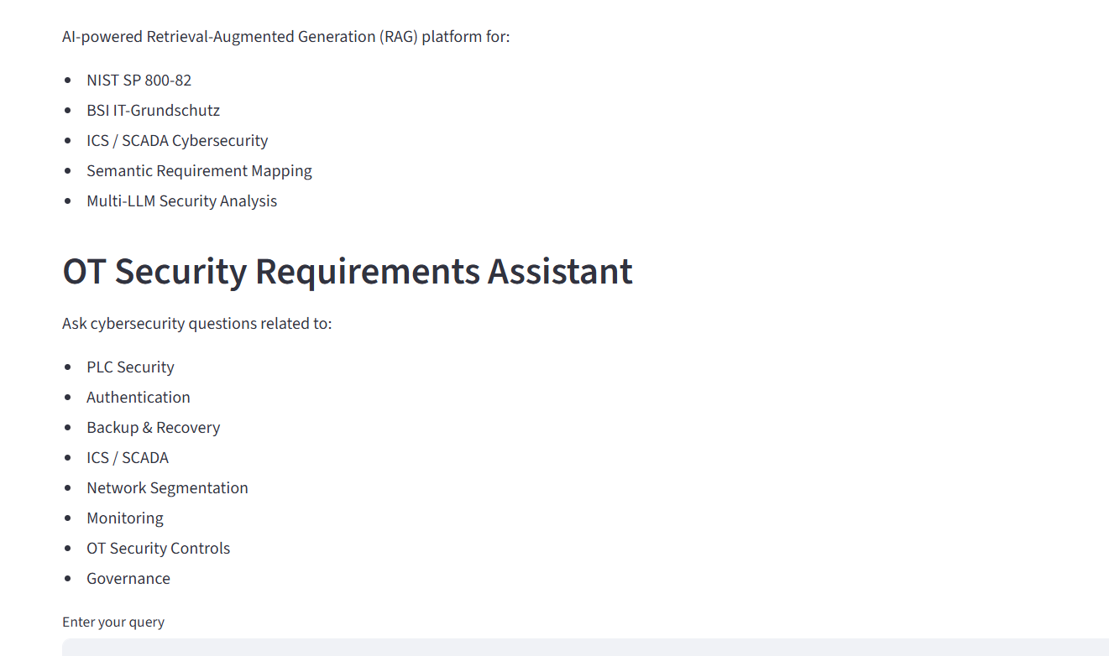
Proposed Solutions
4
Retrieves relevant cybersecurity requirements analysis.
Establishes semantic relationships between standards.
Generates context-aware cybersecurity recommendations.
Compares multiple Large Language Models (LLMs).
Evaluates response quality using automated and human evaluation methods.
Notes:
4

Slide 5
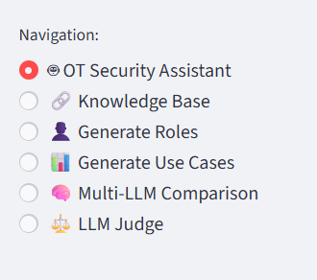
System Components
5
Retrieval-Augmented Generation (RAG)
Semantic BSI ↔ NIST Mapping
Knowledge Base Exploration
Multi-LLM Comparison
LLM-as-a-Judge Evaluation
Human-in-the-Loop (HITL) Evaluation
ARES Evaluation Framework
Notes:
5

Slide 6
Research Questions
6
RQ1: How effectively can RAG Based OT Security Assistant retrieve and analyze the cybersecurity requirements of NIST SP 800-82 and BSI Grundschutz?
RQ2: How accurately can semantic relationships between NIST and BSI requirements can be identified and validated?
RQ3: How do automated evaluation methods(LLM as a judge and ARES) compared with the human loop evaluation when accessing OT cybersecurity responses?
Sub RQ:
Which LLM performs best?
Does semantic mapping improves traceability?
Notes:
6

Slide 7
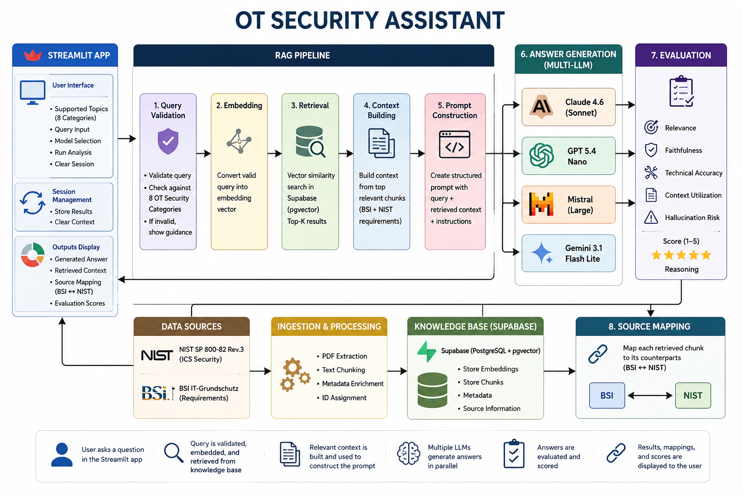
Proposed Architecture
7
Notes:
7

Slide 8
Human-in-the-Loop (HITL) Evaluation
Students evaluate the quality and trustworthiness of the assistant.
Students will access whether the semantic retrieval is relevant or not
Semantic meanings are relevant or not
Explanation is understandable and trustworthy or not
Which LLM provides better explanation.

Slide 9
9
Thank you
Notes:
9

